Slide 1

Final Presentation
<ABC Bank>
<10/10/2021>

Slide 2


Group information
Group name : MBA
Specialization : Data science
Members :
Name | Email | Country | College
Alhamza Ibrahim | hamzi7brahim@gmail.com | Turkey | Turkish-German University
Muhammed Zekeriya | Mohammed.mbz.96@gmail.com | Turkey | Turkish-German University
Bilal YILDIZ | Bilalo.gg@gmail.com | Turkey | Turkish-German University
Github repo : https://github.com/MuhammedZek/MBA-Data-Science-Project

Slide 3
Case Study
Problem : ABC Bank wants to sell it's term deposit product to customers and before launching the product they want to develop a model which help them in understanding whether a particular customer will buy their product or not (based on customer's past interaction with bank or other Financial Institution).
Task : We are analyzing the Data related to banks to help ABC make the right decision before launching their product
After understanding the problem, The work was made through 8 steps :
Gaining insights from the Data
Data preparation
Data Visualization
Conclusion and ML model Recommendations
Preparing the data to fit on the model
Model selecting
Comparing results
Final result

Slide 4
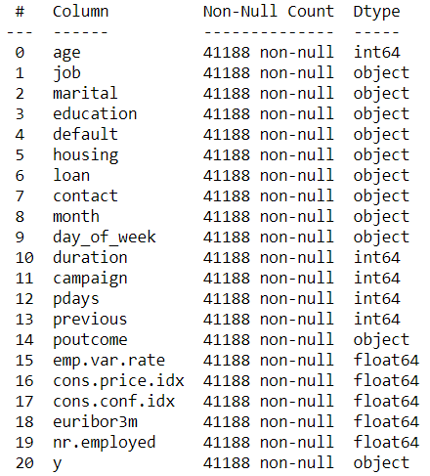
Insights
We have a total of 21 columns (5 of them float64 , 5 Int64 and the rest are objects) without any Null values.

Slide 5
Data preparation
1- Data preparation phase:
Checking for NAN values in Data and dealing with it (already checked)
Checking whether we have imbalanced data or not
Dealing with imbalanced data (if found)

Slide 6
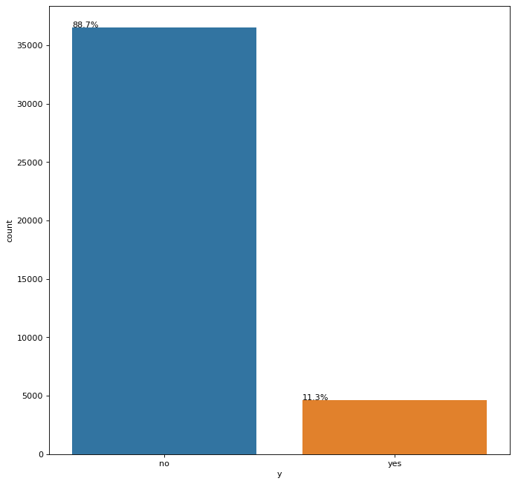
Data preparation
The Data we have contains 41188 Row and 21 Columns but the target data (y column) is unfortunately unequally distributed as shown :
We can clearly see that more than 88% of the data is a No and only a small portion (10%) is yes

Slide 7
Data preparation
To overcome this problem we tried many methods including SMOTE and the results are phenomenal!
We managed to make the data 100% balanced by creating synthetic instances and now we have a total of 73096 rows ( more data = better training)

Slide 8

Data preparation
The data before applying SMOTE method :
The data after :

Slide 9
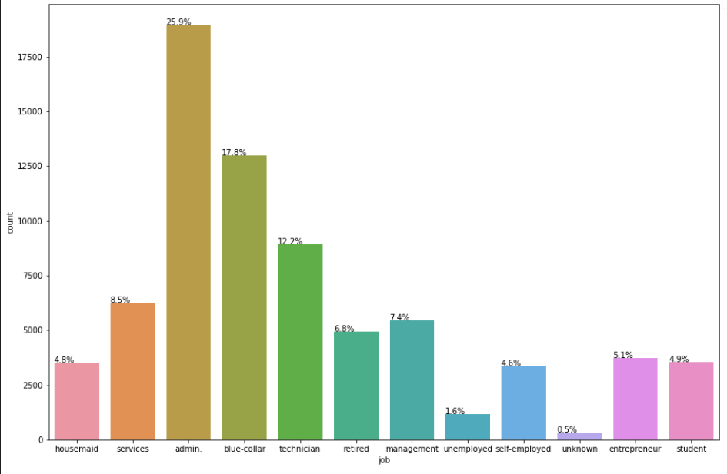
Data Visualization
2- Data visualization
The graph shows the jobs of the bank customers, we can clearly see that admin blue-collar and technician are the top 3 jobs with more than 50% of the whole bank costumers

Slide 10
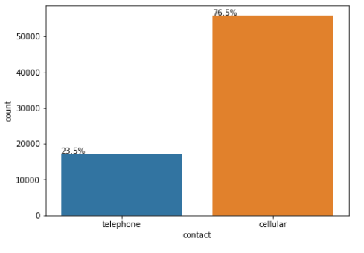
Data Visualization
the costumer that contact the bank by cellular are greater than telephone

Slide 11
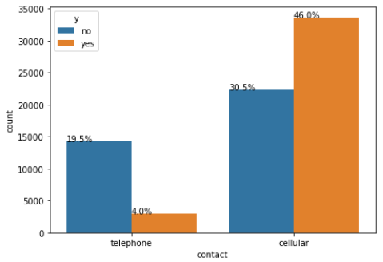
Data Visualization
And the contact’s effect is clear!
People who use cellular are almost 10 times more likely to subscribe to the product that people with telephone.
(46% vs 4%)

Slide 12
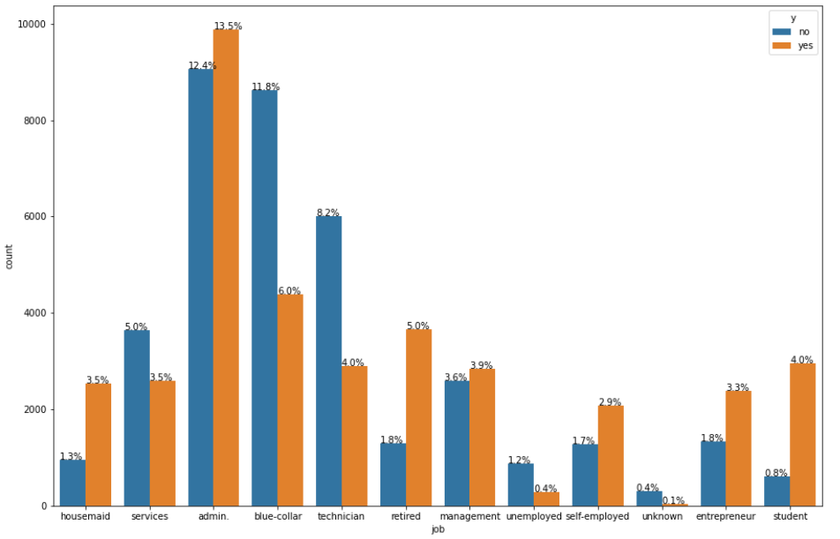
Data Visualization
2- Data visualization
Even though the admin, blue collar and technician are the top 3 jobs in the banks customers, the people who subscribe the most are students ( for every 5 subscribers 1 does not subscribe)

Slide 13
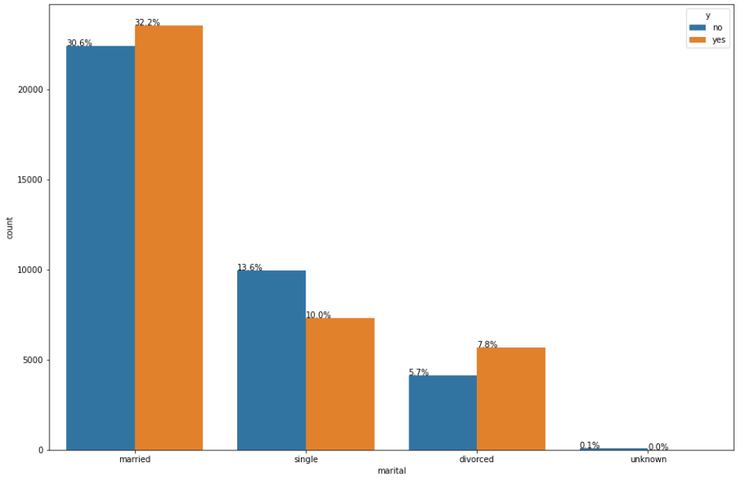
Data Visualization
Social status seems to be somewhat important.
Married and divorced people seem to be more likely to subscribe

Slide 14
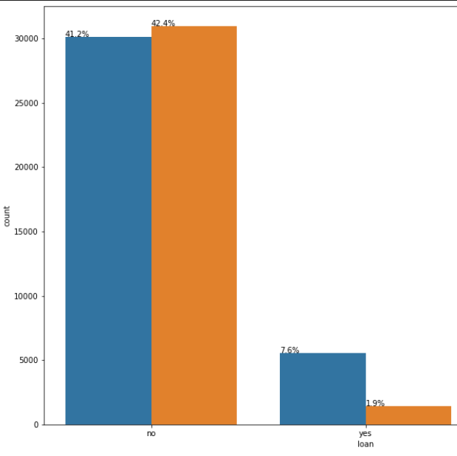
Data Visualization
People with loans are less likely to subscribe

Slide 15
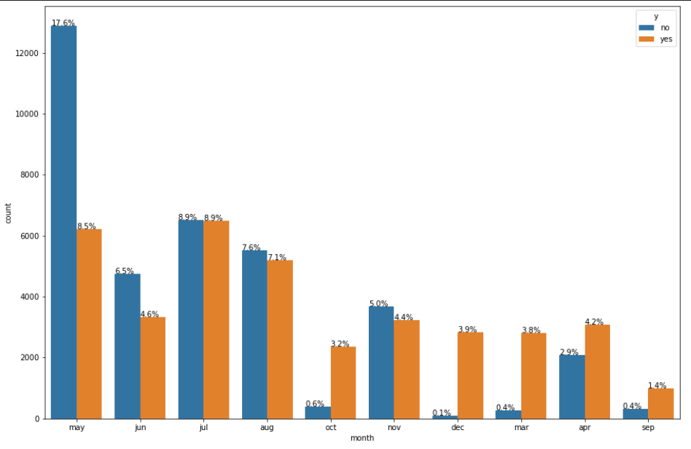
Data Visualization
2- Data visualization
Subscriptions in Mart , April, October in December are the peak of the year, and may is the worst

Slide 16
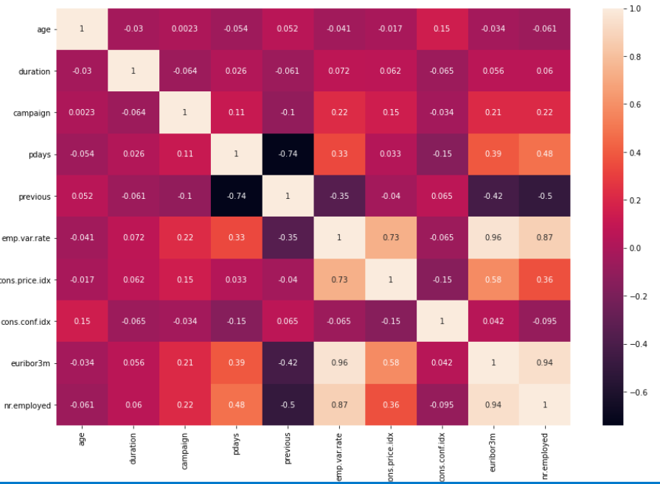
Data Visualization
2- Data visualization
The heat map:
To show the correlation between columns

Slide 17
Recommendations
3- Recommendations
Students and home maids are most likely to subscribe to the product.
People who are married has been contacted more for the deposits by the bank.
The contact type (cellular vs telephone ) plays a role.
People has been contacted more in the month of May than any other month. They have not been contacted in January and Februray at all.
Single people are less likely to subscribe.
People with no personal loan has been contacted more by the bank.
People who are in university has been contacted more by the bank.
Age,Duration,Campaign have outliers and are rightly skewed.
Pdays have more than 70% of data imputed so it is better either to impute or remove the column.
Euribor3m with nr.employed and emp.var.rate with nr.employed with the highest correlation

Slide 18
Model Recommendations
(technical user)
Since the data contains many columns with categorical data which are going to increase the dimensionality (e.g. after applying one-hot encoding) we recommend using PCA for dimensionality reduction.
We recommend starting with tree-based models like Decision Tree, Extra Tree and the Random forest classifier because they are simple yet effective models.
Lasso and Ridge classifiers can also be used in case PCA didn’t give any improvements in the results
Accuracy score can be used as an accuracy metric since the problem is classification problem.
Only choosing the model is not sufficient, Tuning the hyper parameters plays a huge rule.
Finally we recommend using more than one model, tuning the hyperparameters and settling for the best model (accuracy-wise)

Slide 19
Preparing the data to fit on the model
As we know, the Machine learning models work with numerical data only, so we had to convert all the non- numerical data columns into numerical and that was done with help of Ordinal Encoder for columns that contains yes or no instances and OneHotEncoding for the rest of the columns.
Another problem that appeared after applying the Onehotencodeing algorithm is the increase of the dimensions, we used PCA (Principal component analysis) to help with the dimensionality reduction After scaling the data on a Min-Max scalar

Slide 20
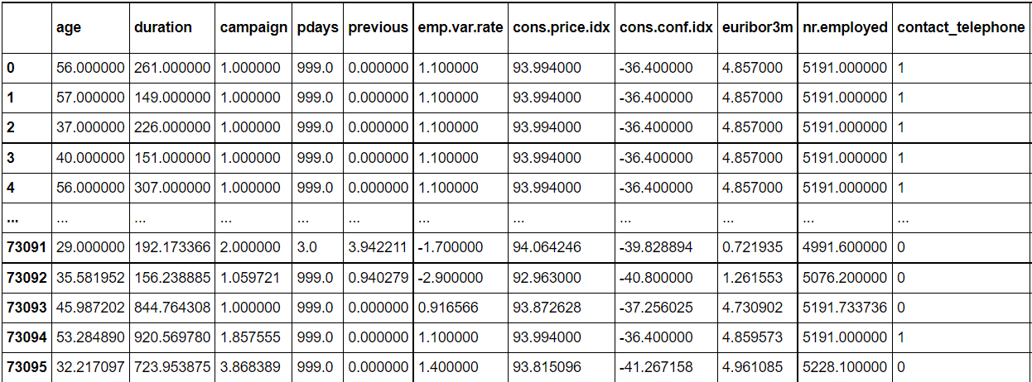
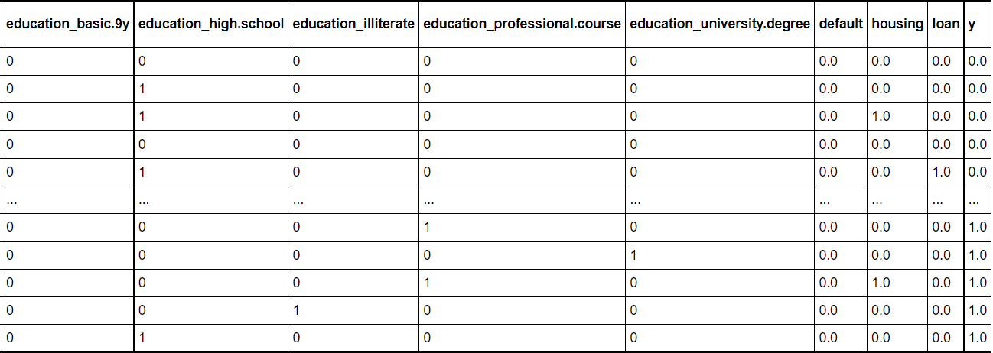
Preparing the data to fit on the model
And the final data set is now all-numeric, feature-scaled and with reasonable number of dimensions and ready to be used for training

Slide 21
Model selecting
From Scikit-learn library:
Logistic Regression
Random Forest Classifier
Ada Boost Classifier
SVC (Support Vector Classifier)
K Neighbors Classifier

Slide 22
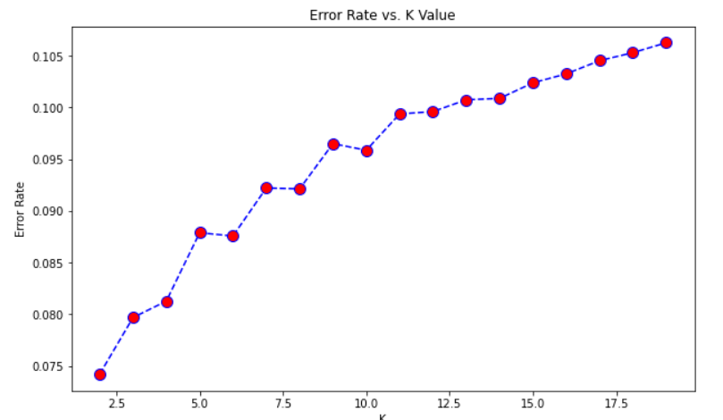
Model selecting
Chossing the right parameters for the model:
K Neighbors Classifier => K value vs. Error Rate

Slide 23
Comparing results
ML Algorithm | Result
Logistic Regression | 0.90
Random Forest Classifier | 0.93
Ada Boost Classifier | 0.94
SVC (Support Vector Classifier) | 0.85
K Neighbors Classifier | 0.93

Slide 24
Final Result
We can not say for sure that one of them is the best because the results seems very close.
So the first three ML algorithm are:
Random Forest Classifier
Ada Boost Classifier
K Neighbors Classifier

Slide 25
Thank You

